Slide 1





Cultivating and Managing an Inclusive Culture at ONRR
Annual Interagency Accessibility Forum
November 9, 2023
Maroya Faied
Lindsay Goldstein
Office of Natural Resources Revenue

Slide 2
Overview
Introduction
Team culture
508 project
Success factors
Continuing success
Culture shift

Slide 3
What’s ONRR (Office of Natural Resources Revenue)
ONRR is a small federal agency within the U.S. Department of the Interior. ​
While you may not have heard of us, we collected over 22 BILLION dollars in revenue in fiscal year 2022.​
These funds are disbursed to federal and local governments, and tribal nations. ​
Even though we serve a targeted subsector of the population, our websites receive a significant amount of traffic.

Slide 4







Who are we?
Open Data, Design, and Development (ODDD)
Office of Natural Resources Revenue (ONRR)
Product Manager
Maroya Faied
Customer Experience
Lindsay Goldstein
Content Strategist
Christine Thomas
Developer
Jeff Schwartz
UX Designer
Erin Elzi
UX Designer
Alexandra McNally

Slide 5
Our websites
The ODDD team was created through development with 18F for the Extractives Industries Transparency Initiative (EITI) in 2014.​
Through this collaboration, we developed revenuedata.doi.gov and the project was fully transitioned from 18F support to ONRR in 2018.​
In 2020, ONRR leadership assigned the ODDD team to manage and redesign ONRR’s other public website, onrr.gov.​
We work in the open and have GitHub wikis that detail our work.​
We also regularly publish work progress on our blog.​

Slide 6
Team culture
Agile methodology
Small team
Work planning
Interactions with each other’s work
Skills and backgrounds

Slide 7
ODDD flavored agile methodology
Agile is a development framework that encourages: ​
disciplined project management​
frequent inspection and adaptation​
teamwork, self-organization and accountability​
rapid delivery of high-quality product​
a business approach that aligns development with customer needs and company goals

Slide 8
Our 2-week sprints (DevOps)
Each 2-week sprint includes daily standups, sprint planning, weekly sync up, sprint demo, and sprint review/retro.​
We decide what individuals are working on at the beginning of each sprint. We define sprint goals based on previous velocity estimates.
Week 1
Sprint planning
Standup
Sync up
Standup
Standup
Standup
Week 2
Standup
Standup
Sync up
Standup
Demo
Sprint review/
retro
Standup
Notes:
Diagram demonstrating our two-week sprints.
Week 1
Monday: Sprint planning
Tuesday: Standup & synch up
Wednesday: Standup
Thursday: Standup
Friday: Standup
Week 2
Monday: Standup
Tuesday: Standup & synch up
Wednesday: Standup
Thursday: Demo, sprint review & retro
Friday: Standup

Slide 9
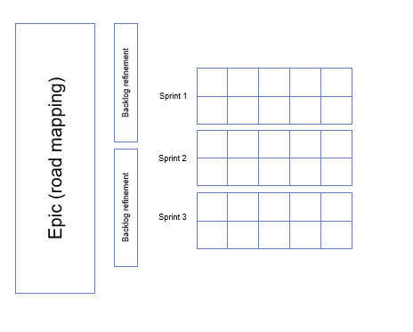
Longer-term planning (DevOps, product management)
We start each epic with a road mapping session that helps us plan what work will be completed over 6 weeks.
We refine the backlog once a month. We remove old issues and prioritize and estimate ones we want to keep. ​
We conduct ad hoc design studios, as needed, to shape solutions for larger projects.

Slide 10
Agile meetings
Meeting | Description | Regularity | Duration
Sprint planning | In sprint planning, we select tasks based on the sprint goals and assign them to individuals. We also prioritize tasks to complete first. | First Monday of each new sprint | 1 hour
Sprint demo | Sprint demos allow the team to present work completed to other team members and stakeholders. They also create opportunities to others to ask clarifying questions. | Second Thursday of each sprint | 1 hour
Sprint review & retro | During the sprint review half of this meeting, we review any issues left in the backlog, close what we can and move others to the next sprint. The retrospective half allows the team to reflect on the sprint and discuss what’s working and what’s not. | Second Thursday of each sprint | 1 hour
Standup | Daily standup meetings allow team members to share progress on assigned tasks and surface any blockers to their work. | Daily | ½ hour
Road mapping | Road map check in meetings allow the team to plan epics, which last for 6 weeks. We also review quarterly goals in this meeting. | Every 6 weeks | 1 hour
Backlog grooming | During backlog grooming, the team goes through open issues. We close duplicate or unnecessary issues. We assign and add estimates and labels for remaining issues. | Monthly | 1 hour

Slide 11
Agile team roles​
Role​ | Responsibilities​ | Currently Filled By​
Product Owner​ | Defines the product vision and makes sure what we’re working on carries out that vision.​ | Maroya Faied​
Developer​ | Writes the code, develops the technical strategy, and decides on technical tool sets.​ | Jeff Schwartz​
Digital Services Specialist (UX)​ | Conducts user research to understand user needs and designs the site to meet those needs.​ | Erin Elzi​ Alexandra McNally​
Digital Services Specialist (CX)​ | Makes sure we have current and accurate data and leads outreach efforts.​ | Lindsay Goldstein​
Content Strategist​ | Develops strategy for and maintains all content on the site.​ | Christine Thomas​

Slide 12
508 project

Slide 13
Poll Question
Do you have a full-time designated 508 Subject Matter Expert in your organization?

Slide 14
Overview - 508 Project
Project plan with existing resources
2-part plan (new docs and existing docs )
Implementation of new policy
Execution of phases (analytics)

Slide 15
Being resourceful
ONRR doesn’t have a 508 coordinator, so we had to create a project plan with only existing resources.
We stopped posting new non-compliant documents to onrr.gov.
Notes:
Notes: Stop the backlog by not adding any new non-compliant documents to the website.

Slide 16
Implementing new policy
Only documents that pass accessibility checks are published online.
It is the document owner’s responsibility to create accessible documents.

Slide 17
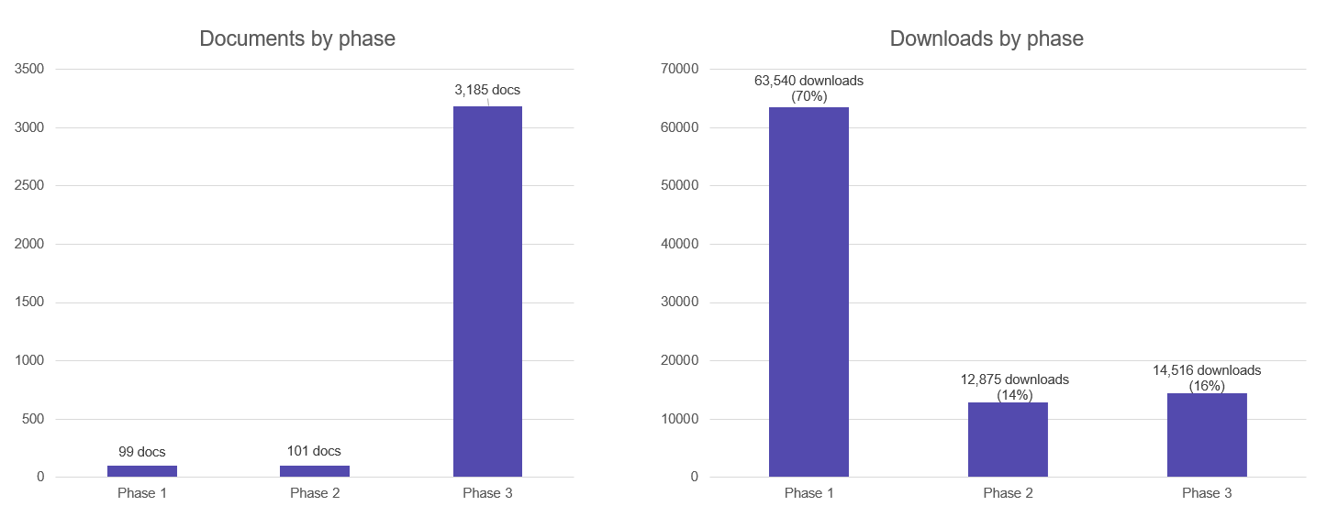
Using analytics to prioritize
Notes:
We used a content inventory to figure out what documents we had before running analytics
We used Google Analytics, and pulled annual data for all document downloads.
Top 100 most downloaded documents made up 70% of all downloads

Slide 18
Success factors

Slide 19
Overview – success factors
Training resources
Executive buy-in
How we work – the day to day

Slide 20
Training Resources
Our ODDD team developed and compiled resources for everyone in our agency. SMEs mainly learned by doing but some also took specialized training.
Accessibility Section on our GitHub wiki
Our GitHub wiki contains links to content we’ve developed and links to external guidance and resources.
Assist with creation of an accessibility toolbox on our internal employee website

Slide 21
Executive buy-in
Our former director initiated the document remediation project and made it a priority.
Our current director fully supports continued accessibility improvements.

Slide 22
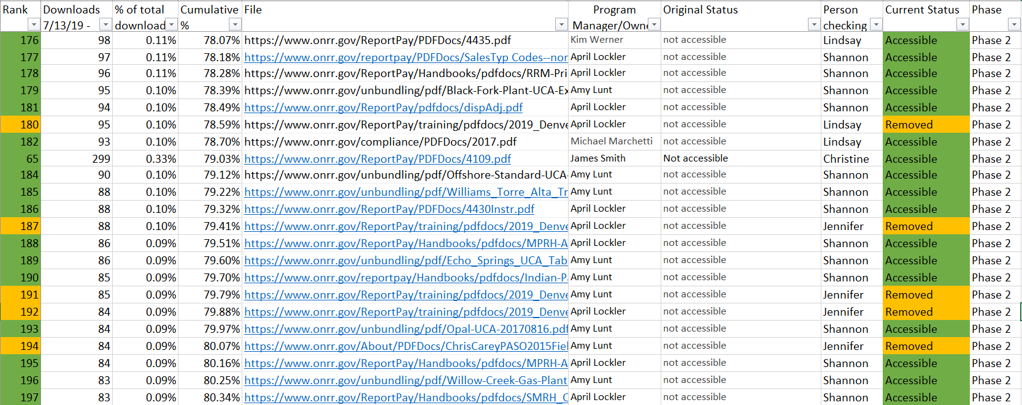
The day to day – tracking sheet

Slide 23
The day to day
Project management tools
Tracking
Clear goals and deadlines
Consistent communication

Slide 24
Continuing success

Slide 25
Overview – continuing success
Workflow
Accessibility goals and metrics
Automatic and manual testing
Annual content audits

Slide 26
Workflow
Require a GitHub issue submission for website updates
Strictly follow accessibility policy
Remediate if needed
Suggest other formats to improve accessibility (limit use of PDFs)

Slide 27
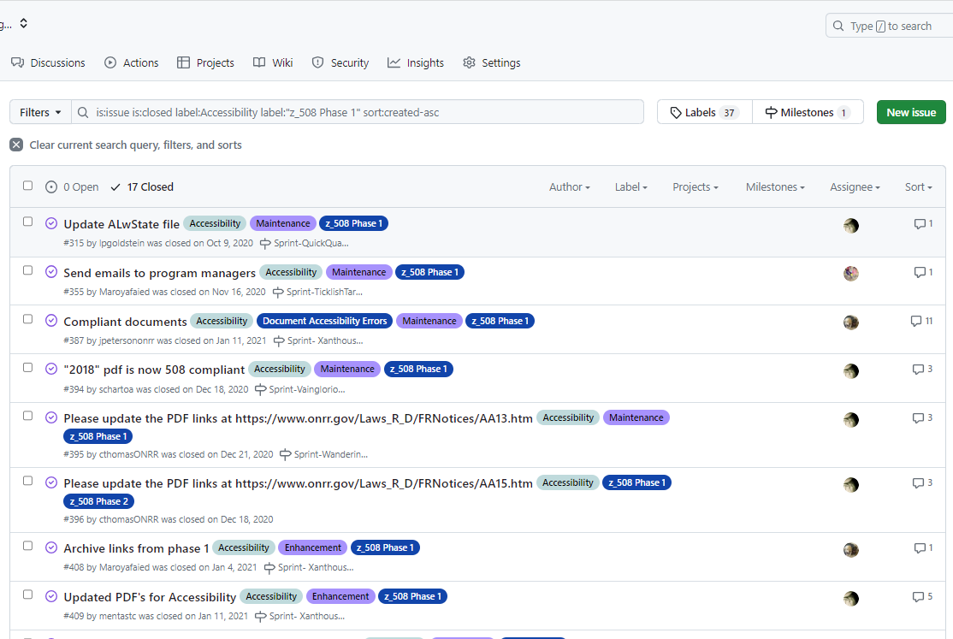
Workflow - GitHub
Labels
Review process
Transparent work process

Slide 28
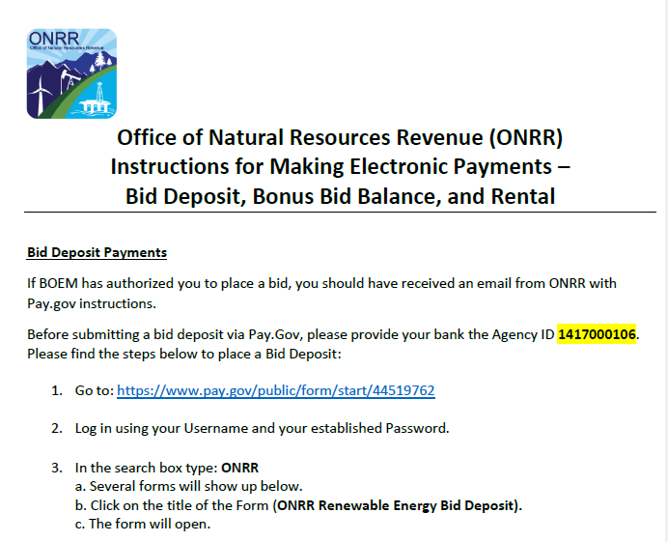
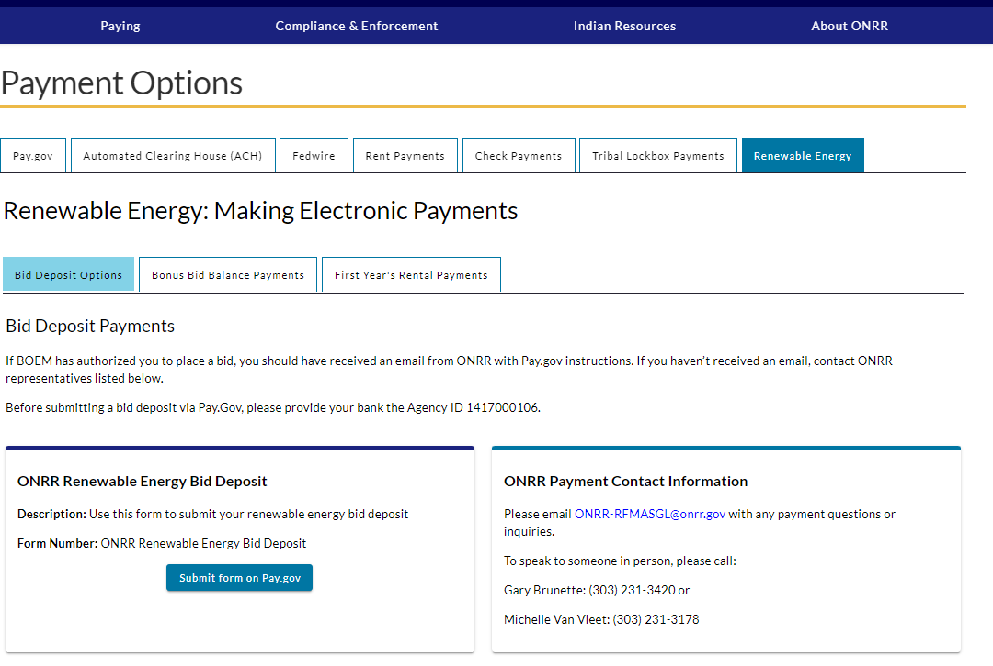
Examples – move beyond the PDF
Submitted document
Outcome

Slide 29
Accessibility goals and metrics
Section 508 Compliance
WCAG 2.2 AAA
Score as high as possible using automated testing tools
ONRR Policy – all posted documents must be compliant
Address accessibility issues from DOI report, Trusted Tester findings for NRRD and onrr.gov
Complete annual mandatory agency assessments
Some of these are extremely difficult to do and we might never get there. But these lofty goals work with our iterative design process.
We’re never “done.”

Slide 30
Automated and manual testing options
Automated
Manual
Lighthouse
Wave
A11y
Level Access
SiteImprove
In-app checkers (Microsoft, Adobe)
CMS Widgets
Screen Readers (NVDA, Jaws)
Trusted Tester (ANDI, ACRT)
Bespoke

Slide 31
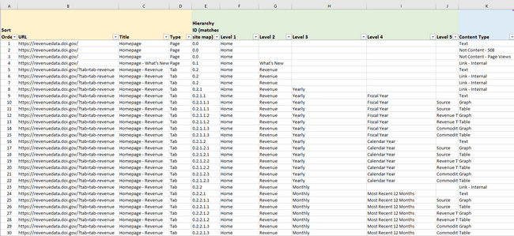
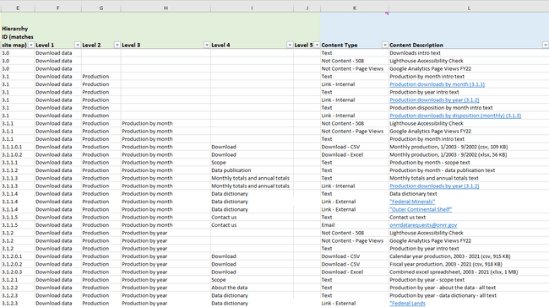
Annual content audits
NRRD content audit

Slide 32
Culture shift

Slide 33
Overview – culture shift
Shared responsibility and collaboration
Enthusiasm for inclusiveness
Knowledge sharing

Slide 34
Shared responsibility and collaboration
Everyone is responsible for creating accessible content and is an owner.
Internal ONRR teams consider accessibility when building new products.
ONRR - DEIA policy
External agencies are motivated to learn!
Center for Medicaid and Medicare, Illinois Department of Employment Security, DOI Equity Office
Outreach & recognitions
Code for America, Partnership for Public Service, Digital.gov, GSA Fedprenuer Show and Tell, Performance.gov, Herocrat, Humans for Public Service, Search.gov, IAAF.

Slide 35
Enthusiasm for inclusiveness
We have ONRR employees who require accessible content to do their jobs.
Once ONRR employees realized how accessibility impacts their colleagues, they were more enthusiastic about the work.
"I am so thankful for the Open Data, Design, and Development team’s dedication to meeting the legal requirements of 508 compliance. I appreciate the improvements being incorporated prior to a full launch." – Sam Herbert
Continuous learning to improve accessibility standards within our agency.
Training in manual testing – Trusted tester
PDF training

Slide 36
Knowledge sharing
Year in review U.S General Service Administration (GSA) report
Performance.gov blog
The Partnership for Public Service blog
The Office of the Federal Chief Information Officer (OFCIO) social media
Recent presentations: Interagency Accessibility Forum, GSA's Fedprenuer Show and Tell, Foreign Service Institute Tech Talk, and Code for America, Center for Medicaid and Medicare digital team
Host cross-trainers and interns

Slide 37
Knowledge sharing- blogs
Relevant blogs
Advanced Section 508 compliance testing: moving beyond automated testing and screen readers
Modernizing a federal government website with user-centered design
Accessibility testing for onrr.gov
Ensuring accessible content beyond the auto checks: making a diagram screen reader friendly

Slide 38
Questions?
Maroya.faied@onrr.gov
Lindsay.Goldstein@onrr.gov
onrrweb@onrr.gov
https://revenuedata.doi.gov/
https://onrr.gov/
https://blog-nrrd.doi.gov/
https://github.com/DOI-ONRR/nrrd/wiki

